Slide 1
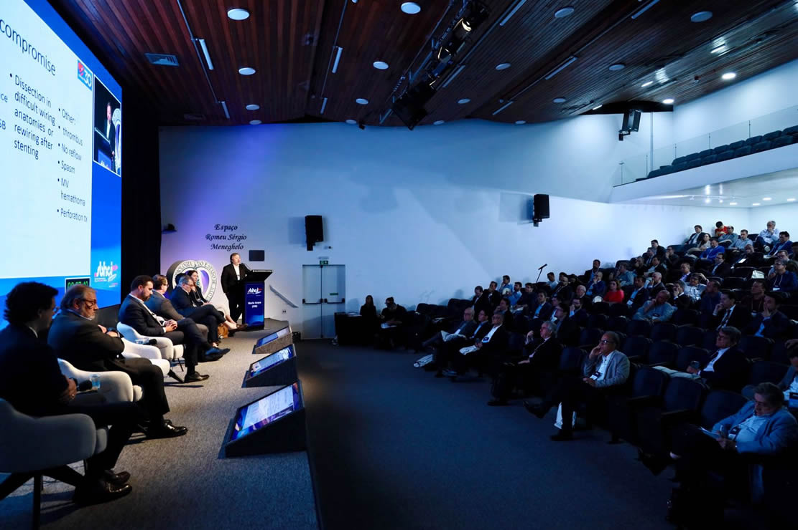

October 9th & 10th, 2025

